Slide 1
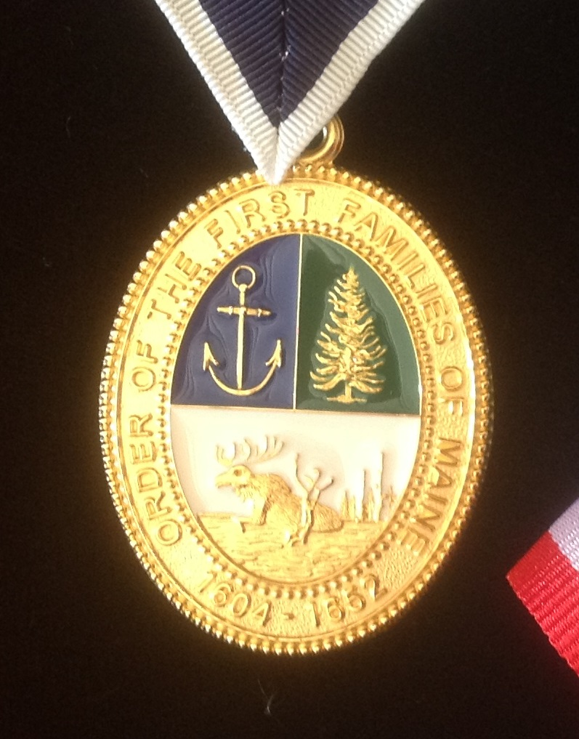
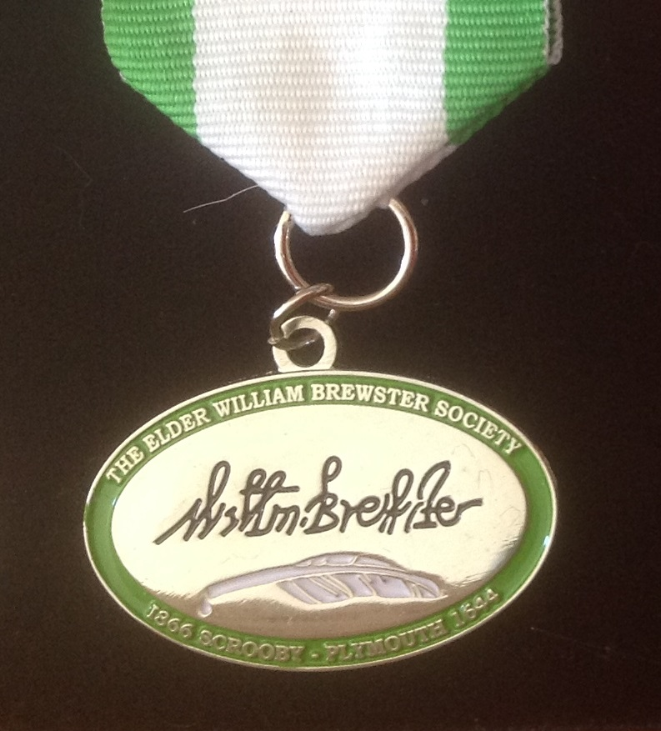
Hereditary Societies
In the U. S. of A.
Sumner G. Hunnewell

Slide 2
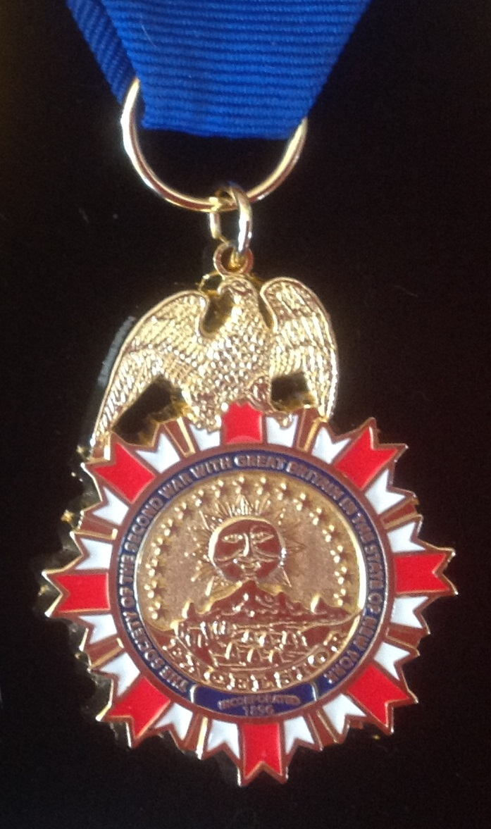
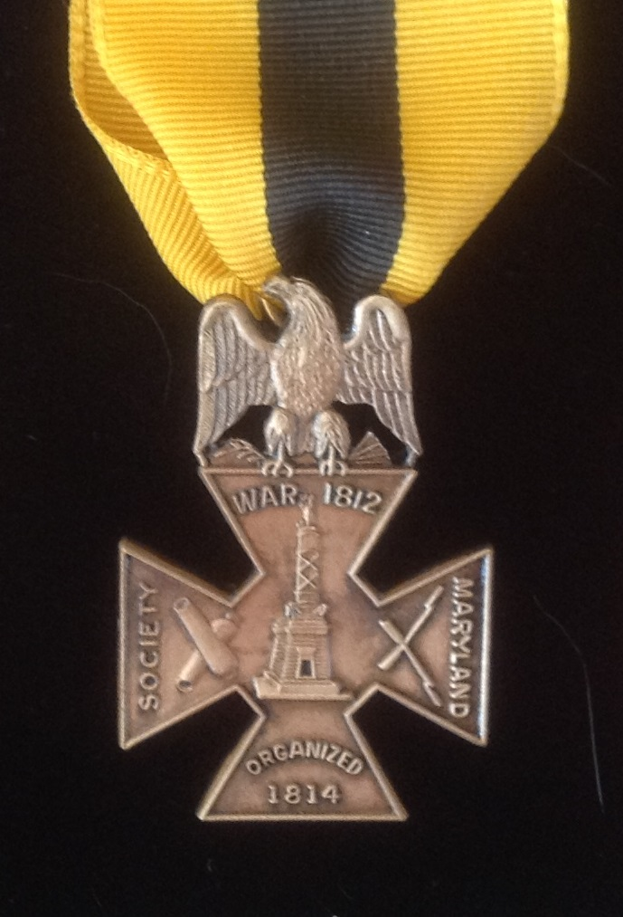
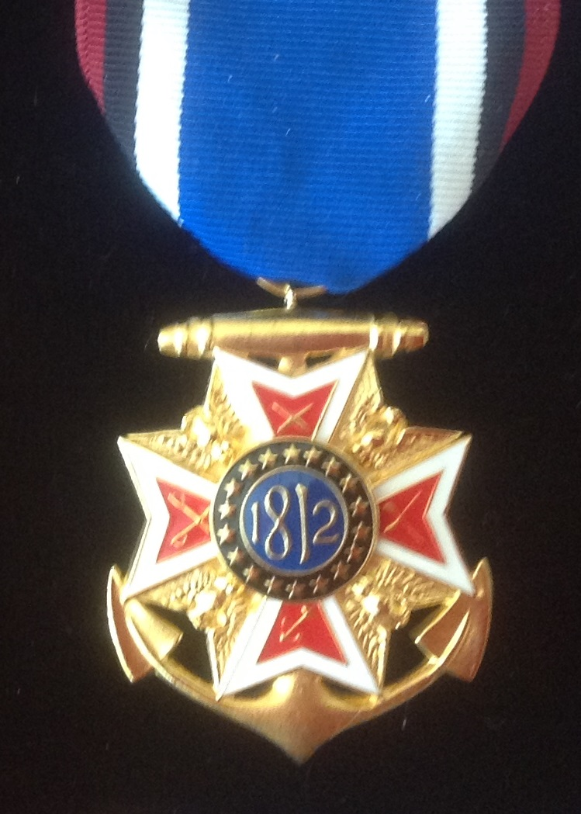
Number of variety of hereditary societies
Based on...
descent of a single person (Charlemagne, Elder William Brewster)
the qualities of a single person (Cincinnati, Colonial Cavaliers)
a family (Wing Family Association, Stetson Kindred of America...)
a particular event (Crusades, Mayflower, Valley Forge...)
a war (Colonial, Revolutionary, 1812, Mexican, Civil...)
Military order (officers: 1812, Civil War...)
a geographical area (Jamestown, Indiana, New England...)
a trade or profession (Flagon & Trencher, Postmasters...)
a religion (Early Quakers)

Slide 3
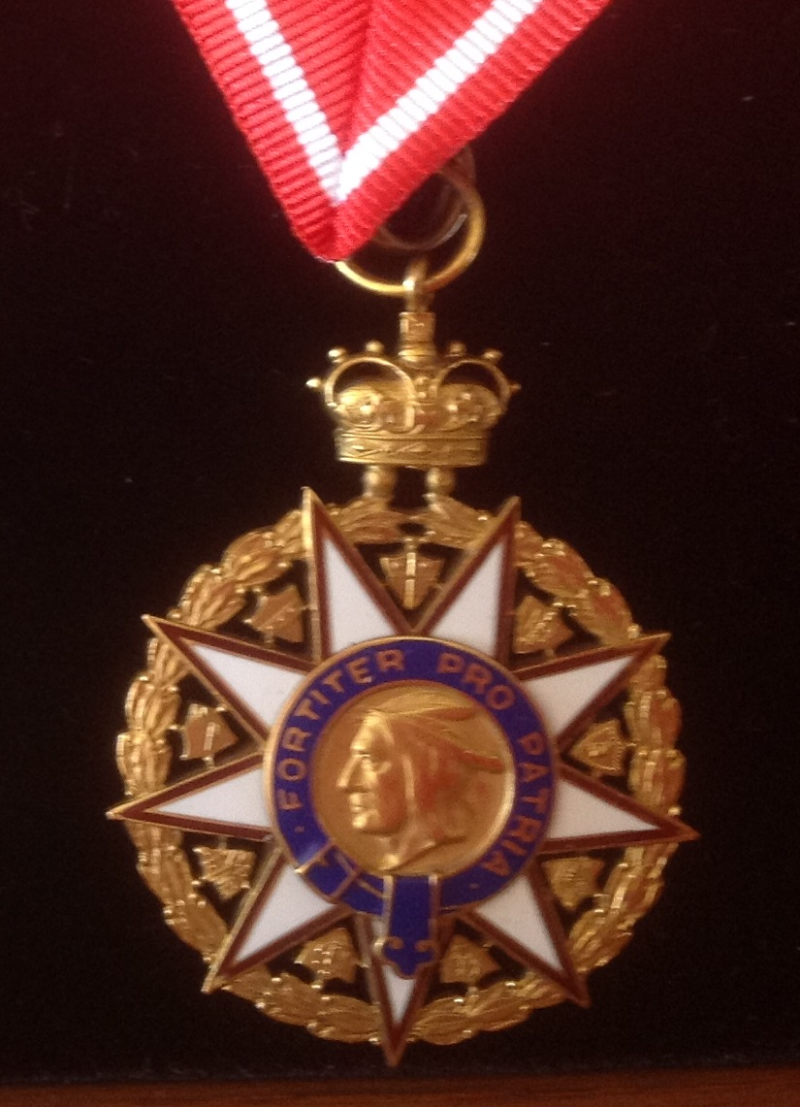
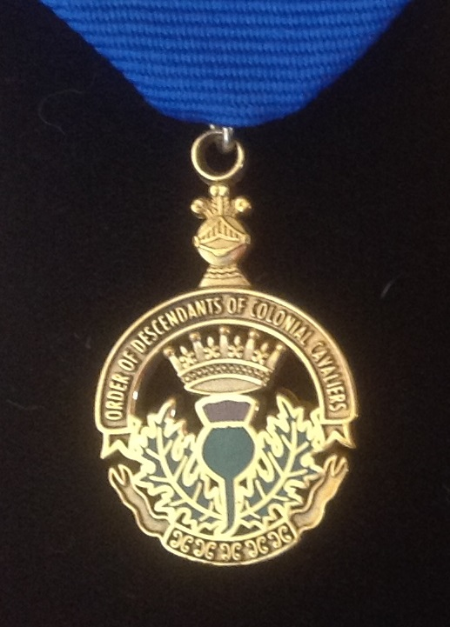
Men’s / Women’s / Inclusive / Exclusive Hereditary Societies
Societies are particular to men
“Sons of”
Societies are particular to women
“Daughters of,” “Ladies of,” “Dames”
Inclusive societies
Proof to your ancestor or collateral ancestor is sufficient
Exclusive societies
Usually proposed by two other members
Invitation only
Limited membership

Slide 4
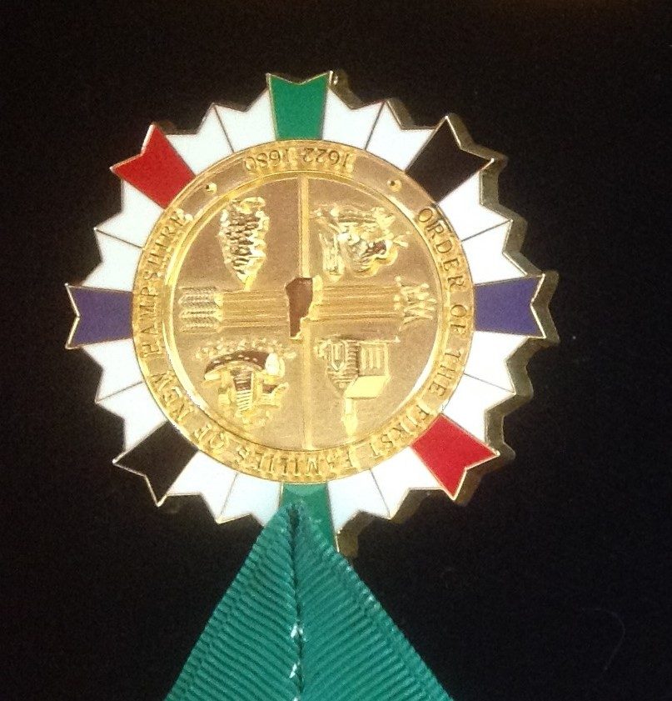
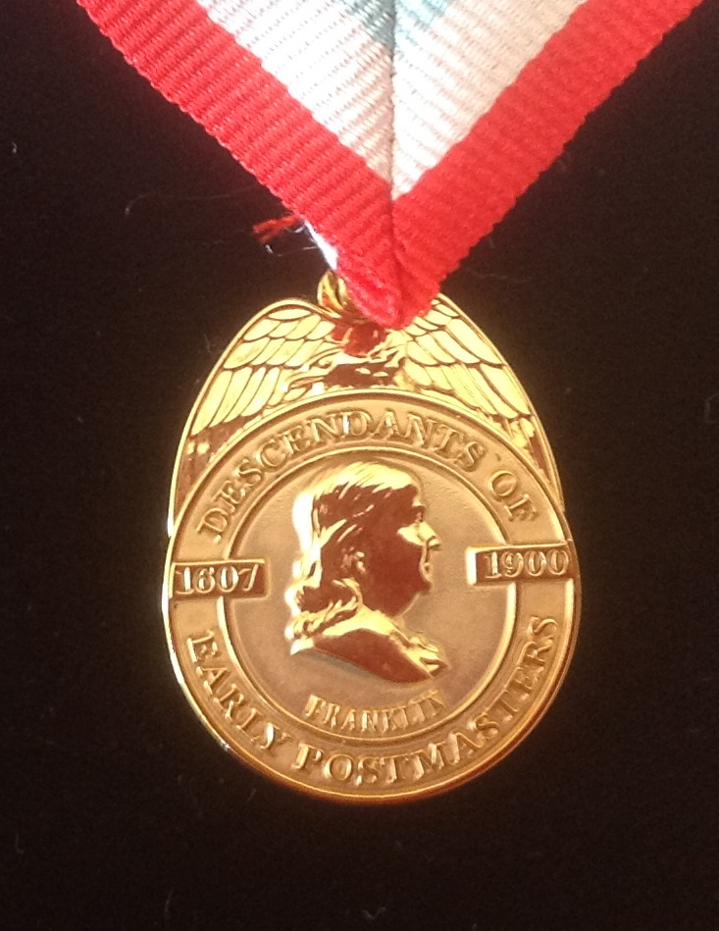
Royal Societies
American “gateway ancestors” proved to be from royal blood
Inclusive or exclusive
Tend to be more expensive to join
Multiple from which to choose
any royal blood,
Plantaganets,
Scottish Kings,
Wessex Kings,
French Kings...

Slide 5
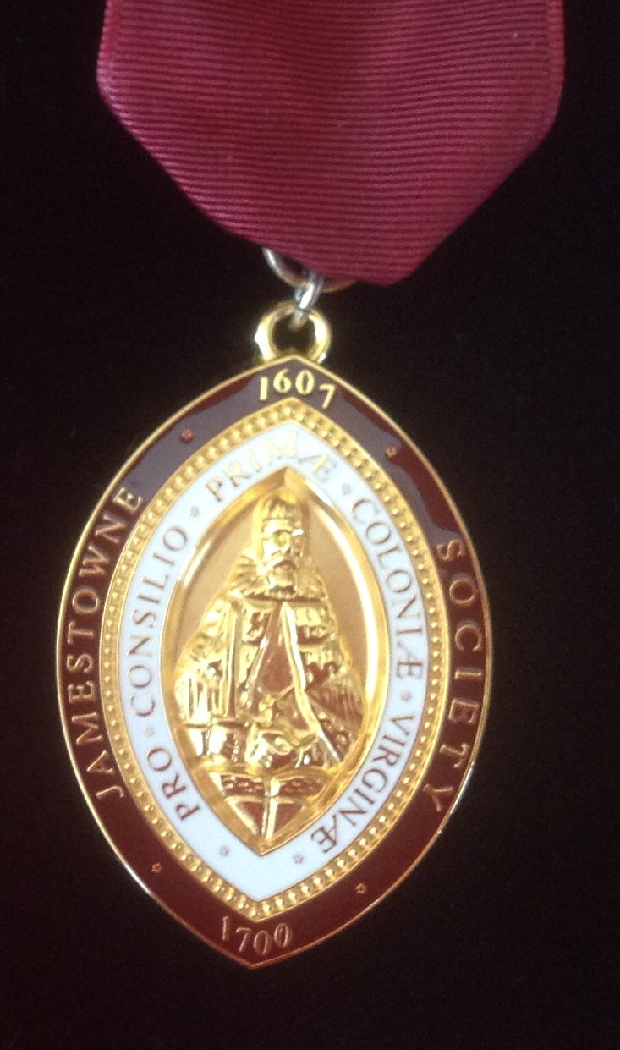
Hereditary Society weekend
Two to three weeks in April
Breakfasts, lunches, teas, and dinners
Most extravagant: Order of the Indian Wars of the United States
Dinners are white / black tie affair
This year: “The evening carte will include Brunswick Stew Lapin as the appetizer, and Traditional English Trifle for dessert. The Entreé will include Antilope Braisée – Longe Rôtie et Saucisse Grillée followed by Fig et Marcona Caille Farcie. There will be open bar prior to dinner. Wine will be presented at table for each course. Programme, Port and Cigars to follow.”

Slide 6
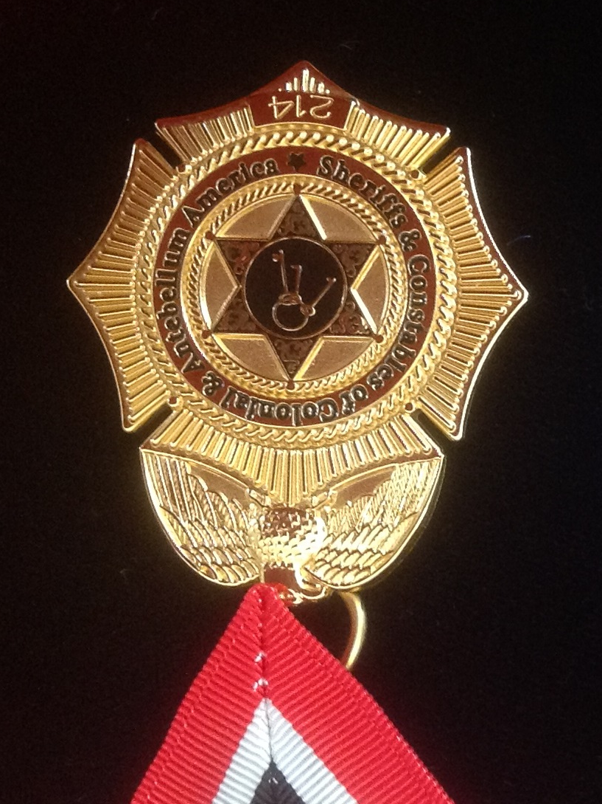
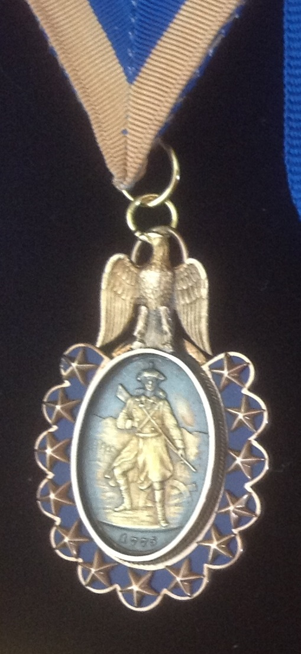
Structure / Benefits
National / State / Locale
Differently named based on history of the organization or event
Benefits
Glossy magazines or offset / photocopied newsletters
PDF e-mail magazines / newsletters
Membership cards
Membership certificates
Insigne
Life membership
The Glory of being part of the XYZ group

Slide 7
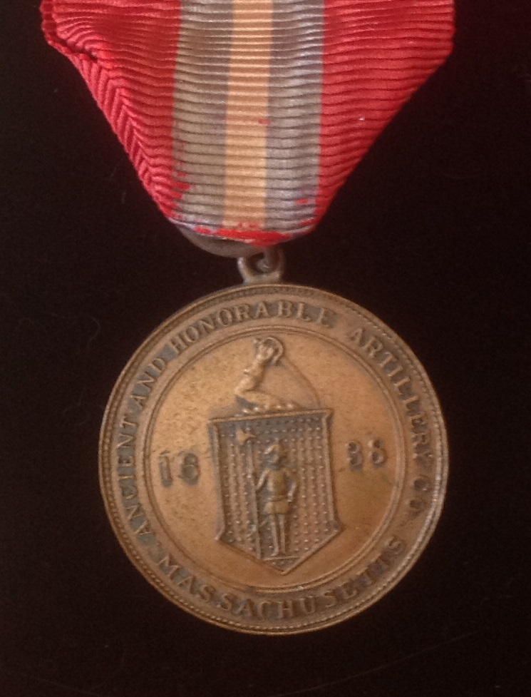
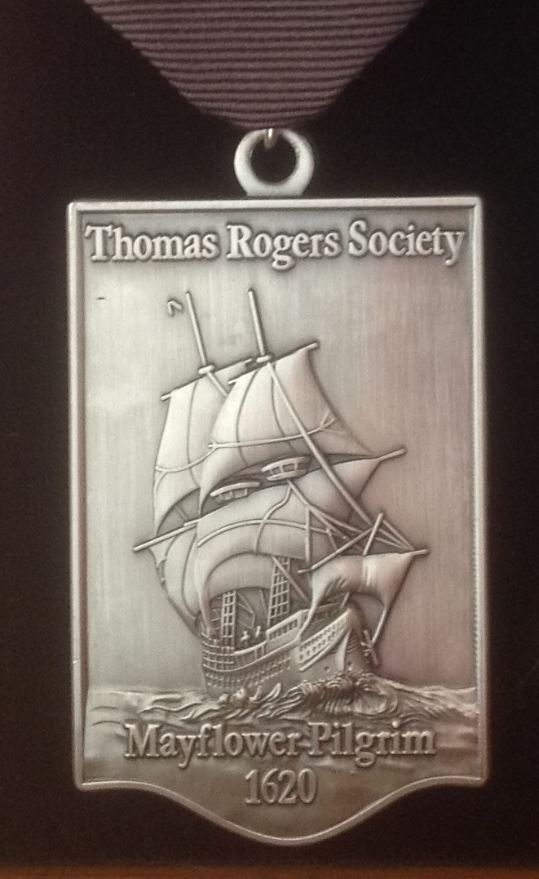
My Favorites
Ancient and Honorable Artillery Company
Right of descent member
Society of Colonial Wars
Enamored with this group since I was in my 20s (exclusive)
Order of the Founders and Patriots of America
Meant to be difficult to join (exclusive) – seven members in Missouri
CHECK OUT: hereditary.us website

